Slide 1
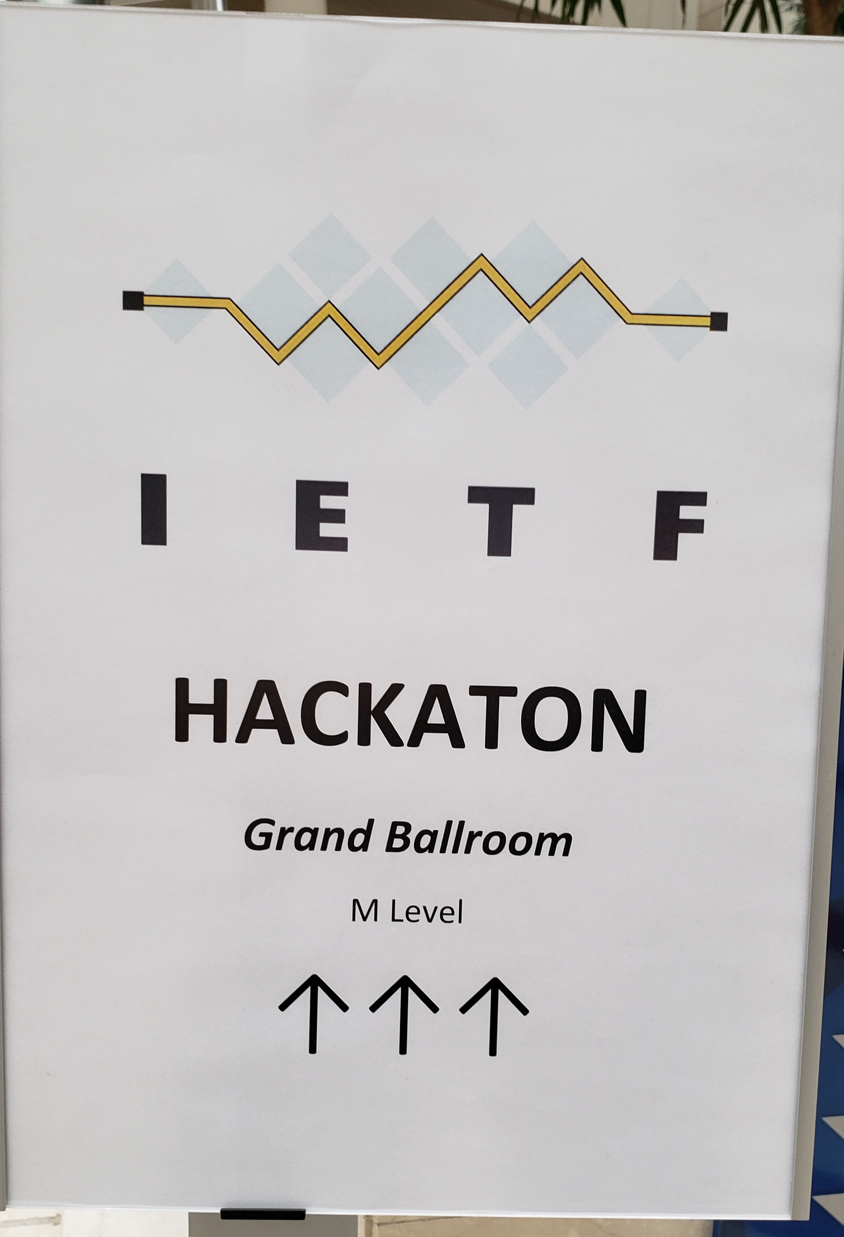
IETF Hackathon: Trusted Execution Environment Provisioning (TEEP)
IETF 104
23-24 March, 2019
Prague

Slide 2
Hackathon Plan
Flesh out implementation issues with OTrP specs:
draft-ietf-teep-architecture-02
draft-ietf-teep-opentrustprotocol-02
(draft is underspecified)
draft-thaler-teep-otrp-over-http-01
Work on implementations and compare interpretations of spec
Validate that spec is TEE vendor agnostic

Slide 3
What got done
Multiple (2) implementations represented
Across 3 types of TEEs (Intel SGX, ARM TrustZone, RISC-V Keystone)
Participants used Open Enclave SDK branch that supports both SGX and TrustZone
SGX+TrustZone implementation of OTrP client & server in progress:
Ported to run over Open Enclave SDK
Added more of OTrP implementation (more use of JWS & JWE)
Updated to match latest HTTP transport spec (changes based on MNot feedback), straightforward
Implemented Trusted Application request mechanism designed (but not implemented) at hackathon 103 but only doc’ed in a github issue

Slide 4
What we learned
Filed Issues: https://github.com/ietf-teep/OTrP
5 new draft issues filed
3 existing issues updated with more info
Summary of new issues:
Relationship between OTrP and attestation (EAT/RATS/etc) needs work (on agenda for this week)
Some OTrP fields look redundant with others, opportunity for mismatch
OTrP spec uses two slightly different cert chain encoding mechanisms (JWS and custom), complicating code
Some OTrP fields (TEE name, TEE version) are underspecified and are interpreted differently by different people

Slide 5
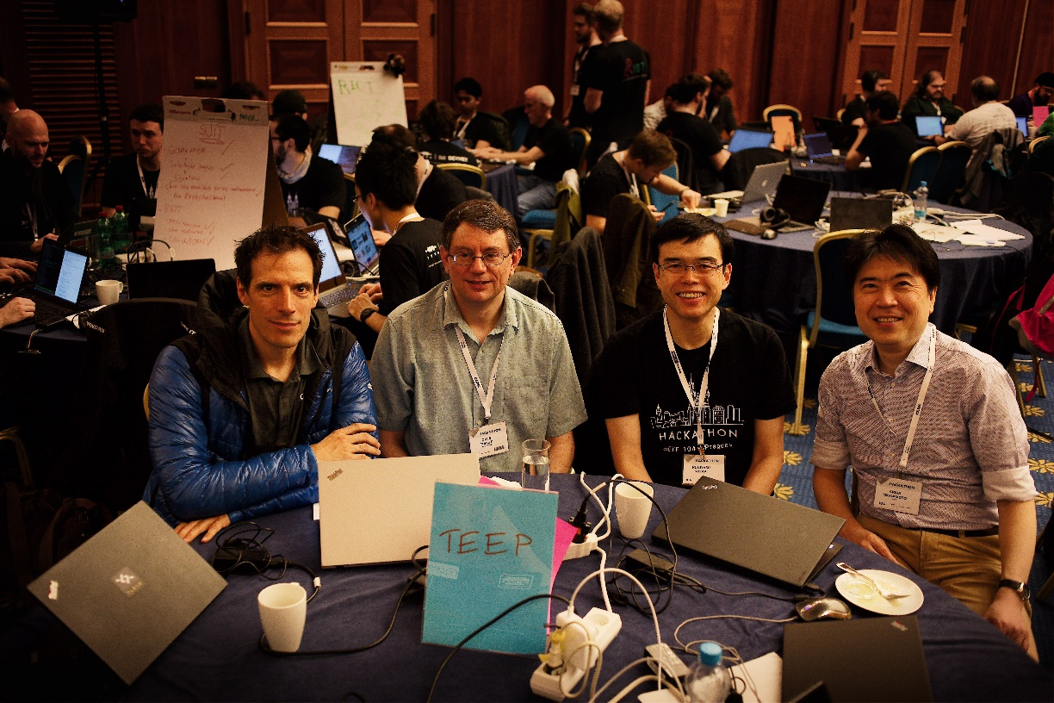
Wrap Up
Team members:
Dave Thaler
Akira Tsukamoto
Kuniyasu Suzaki
Hannes Tschofenig (co-author)
First timers @ IETF/Hackathon: 2
Issues: https://github.com/ietf-teep/OTrP
C Implementation:
https://github.com/dthaler/OTrP

